Slide 1
Few-shot Learning utilizing knowledge graph and Deep Learning
A0206597U Xin Zhengfang
Department of Electrical & Computer Engineering
Faculty of Engineer
National University of Singapore
(ECE NUS)

Slide 2
Content
Few-shot learning
Introduction
Mainstream method
Graph method
Based works: GNN, EGNN
Our contribution
Main contribution
HGNN
Experiments

Slide 3
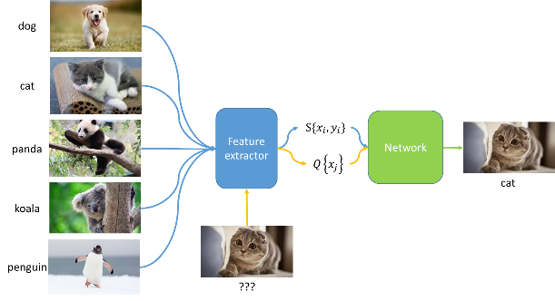
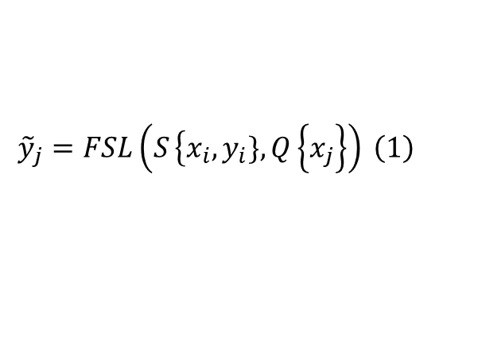
Few-shot learning(FSL)
Inspiration
The few-shot learning problem is inspired by human’s ability to learn from very small number samples to recognize the new object. For example, a human child only saw several pictures of zebra on a brochure, then at next time, the child can recognize a real zebra in a zoo.
$$\begin{aligned}&{\tilde{y}}_{j}=FSL\left(\left.S\left.\left\{x_{i}, y_{i}\right.\right.\},Q\left.\left\{x_{j}\right.\right.\right\}\right) \#\left(1\right)\end{aligned}$$

Slide 4
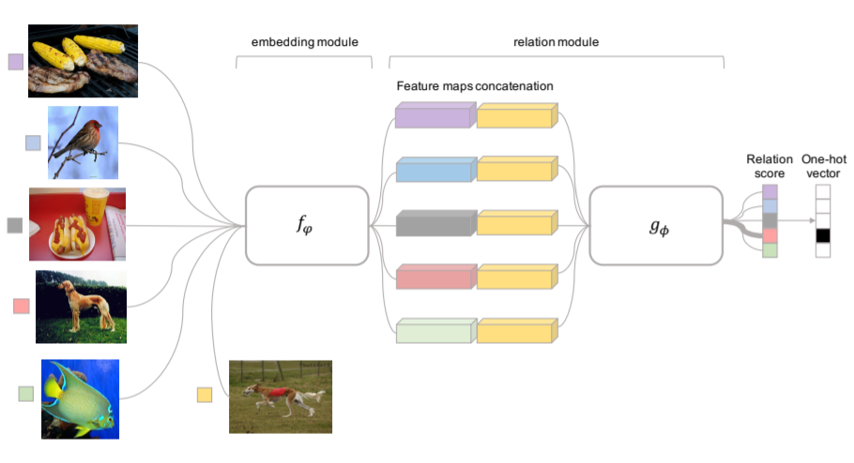
Mainstream method
The mainstream method of solving FSL is to construct feature map relation pair. The relation pair will be fed into the CNNs to calculate the similarity score.
Then predict unseen images based on support images.
[1] F. Sung, Y. Yang, L. Zhang, T. Xiang, P. H. S. Torr, and T. M. Hospedales, “Learning to Compare: Relation Network for Few-Shot Learning,” arXiv:1711.06025 [cs]

Slide 5
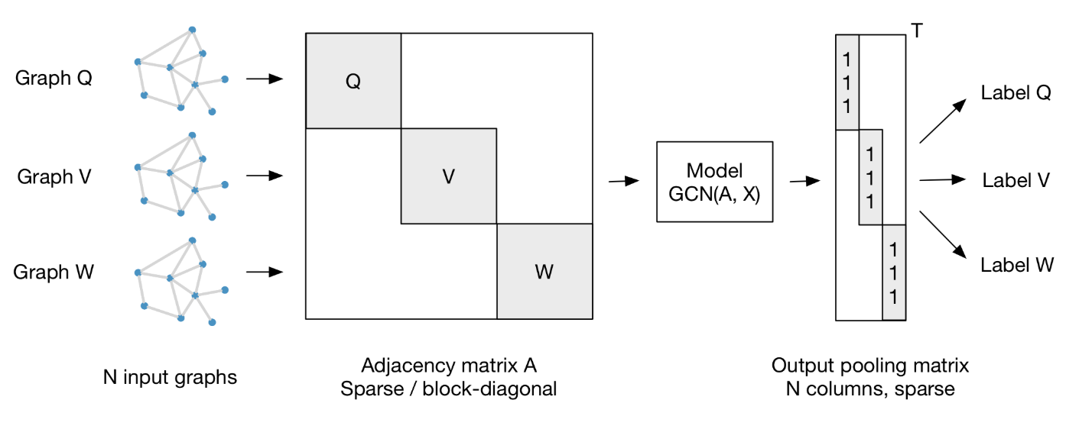

Another method: Graph Convolutional Networks (GCN)
Inspiration
CNN can not directly solve the non-Euclidean data, which data formed as non-regular space.
In FSL problem, it naturally is a graph structure that can be solved by GCN.
GCN can achieve close performance but with less parameters by only using shallow neural network
[2] T. N. Kipf and M. Welling, “SEMI-SUPERVISED CLASSIFICATION WITH GRAPH CONVOLUTIONAL NETWORKS,” p. 14, 2017.

Slide 6
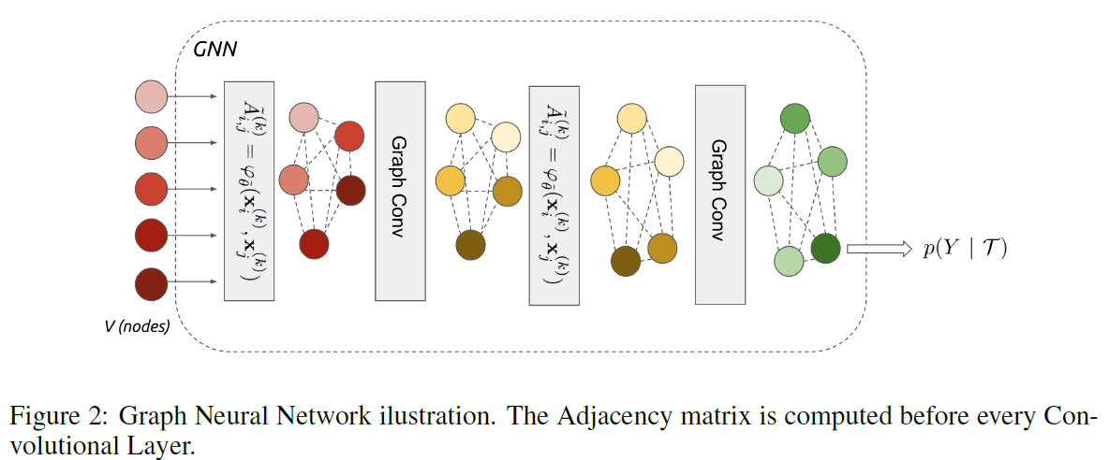
Based work: GNN
Instead of using relation pair, graph-based methods use graph to represent the whole relationship in each task.
Basic method is that GCN aggregates messages among the graph, and MLP updates the distance between nodes.
[3] L. Gong and Q. Cheng, “Exploiting Edge Features for Graph Neural Networks,” p. 9.

Slide 7
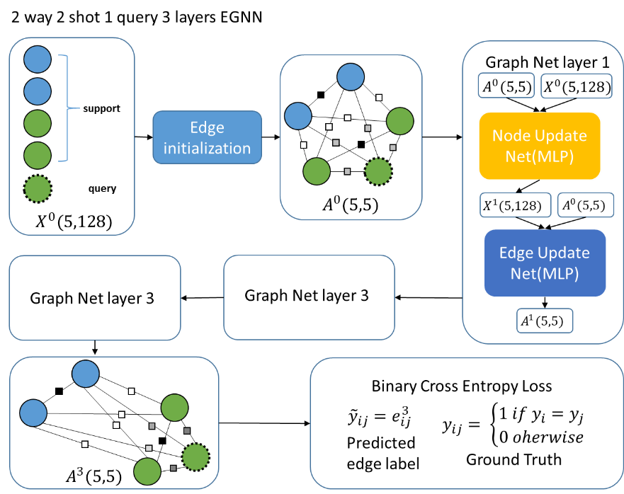
Based work: EGNN
EGNN is the edge version of GNN. Instead of predicting based node features, EGNN votes the label by the adjacent matrix.
The edge-labeling framework can explicitly perform the clustering with representation learning and metric learning.
[4] J. Kim, T. Kim, S. Kim, and C. D. Yoo, “Edge-Labeling Graph Neural Network for Few-Shot Learning,” p. 10, 2019.

Slide 8
Main contribution
We propose a new method (Hierarchical Graph Neural Networks for Few-Shot Learning) (HGNN-FSL)for few-shot learning problem by noticing the flat structure of GNN and EGNN.
HGNN-FSL achieves a state-of-the-art performance in two popular few-shot learning dataset, MiniImageNet and TieredImageNet in GCN based methods
Our hierarchical is based on Graph U-Net[4]. We also propose novel pooling methods(intra & inter k-nearest pooling) for this specific task.
[5] H. Gao and S. Ji, “Graph U-Nets,” arXiv:1905.05178 [cs, stat], May 2019.

Slide 9
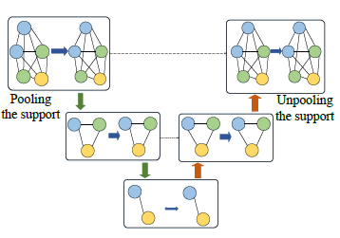
HGNN-overview
GNN
EGNN
HGNN

Slide 10
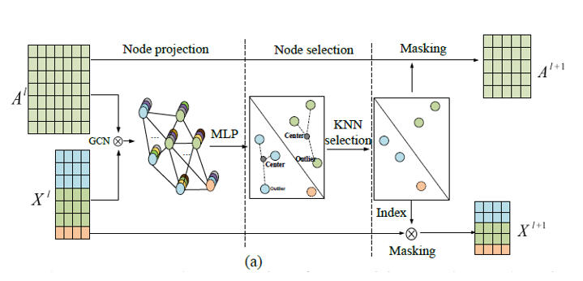
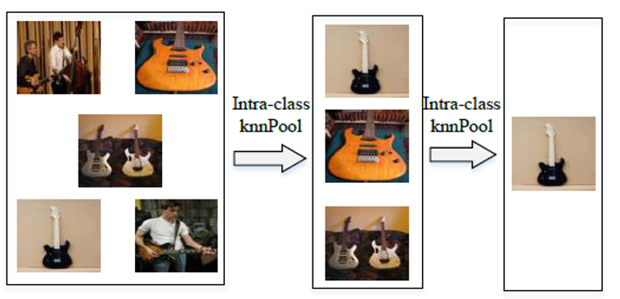
HGNN-Intra pooling
Goal :
Minimize intra-divergence.
Pool out noise nodes and leave representative nodes in each class;
Make sure that the graph studies from representative nodes of each class.

Slide 11
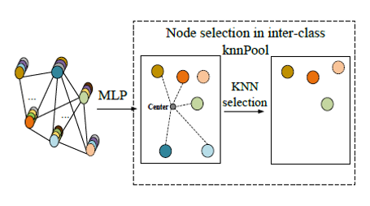
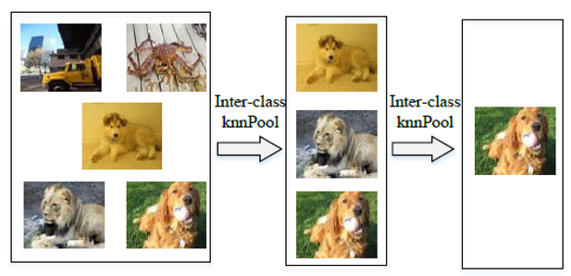
HGNN-Inter pooling
Goal:
Maximize inter-divergence.
Filter out low contrastive nodes;
Make sure that the graph studies from discriminative nodes.

Slide 12
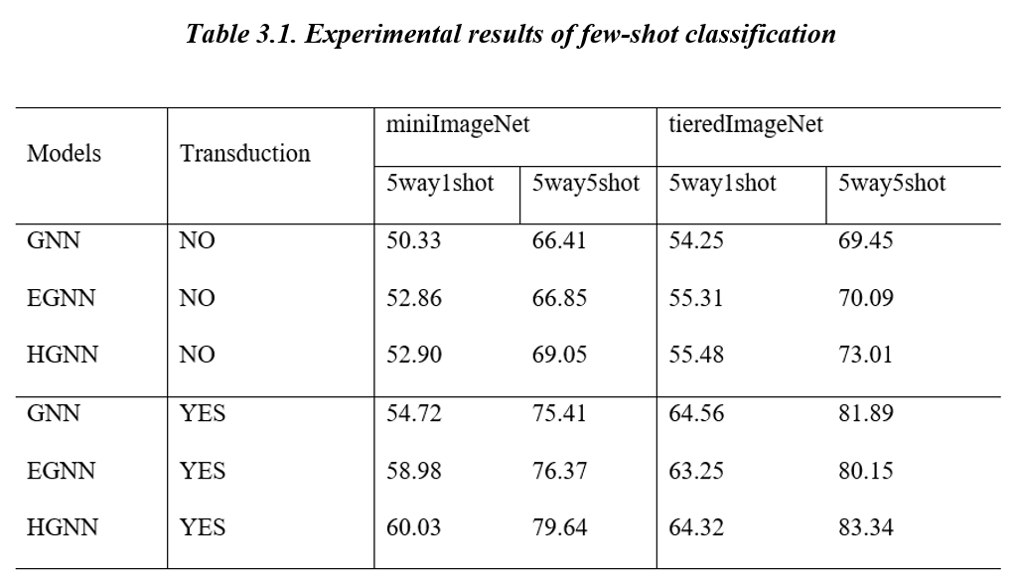
EXPERIMENTS
Code is available on github: https://github.com/haofengsiji/HGNN-FSL

